Slide 1


Employee Analysis | Attrition Report
Data Visualization Course - Sekolah Data Pacmann
pacmann.io
© 2022 – Pacmann AI

Slide 2
Outline
Introduction
Dataset
Objective
A glimpse of information about Attrition
Visualization
Insight & Analysis

Slide 3
Introduction
Notes:
Transisi antar outline

Slide 4
Introduction
I’m Nurul Maulidya, student from BI Program Batch 10. Herewith I created this project with the intention to explore my own ability in exploring data and analyzing the insight of the data with the knowledge I got from Data Visualization class in Pacmann. Despite the fact that I still had to learn a lot about data visualization, that doesn’t stop me from giving the best that I could to finish this porject. By finishing the project, I hope I can gain some feedback to improve the way I manage data and make a visualization out of it. Thank you for facilitating all of the students to create the project, Pacmann.

Slide 5
Dataset
Notes:
Transisi antar outline

Slide 6
Dataset
The dataset that is taken for this topic as I would like to explore more about something that is related to my current position as someone who works in HR field. Employee attrition happens when the size of the workforce diminishes over time (the gradual reduction in employee numbers). Commonly referred to as a 'churn rate,' a company's attrition rate is the rate at which people leave. If we break it down, it is the number of people who have left the company, divided by the average number of employees over a period of time. This means that employees are leaving faster than they are hired. Employee attrition happens when employees retire, resign, or simply aren't replaced.

Slide 7
Objective
Notes:
Transisi antar outline

Slide 8
Objective
Uncover the factors that lead to Employee Attrition by observing such variables: Education, Environment Satisfaction, Relationship Satisfaction, Work Life Balance, Job Involvement, Job Satisfaction, and Performance Rating.

Slide 9
A glimpse of information about Attrition
Notes:
Transisi antar outline

Slide 10
A glimpse of information about Attrition
No matter what industry we are in, it's normal for employees to come and go. Some employees leave their job because they may have found a better job opportunity. Others leave because they're retiring, they've been let go, or even due to illness. Employee attrition is the gradual reduction in employee numbers.
Types of employee attrition:
Involuntary attrition
Voluntary attrition
Retirement attrition
What causes employee attrition:
Poor job satisfaction and pay
Not enough career opportunities
Poor workplace culture
Lack of employee motivation
Poor work-life balance
Not fitting in and feeling a sense of belonging

Slide 11
Visualization
Notes:
Transisi antar outline

Slide 12
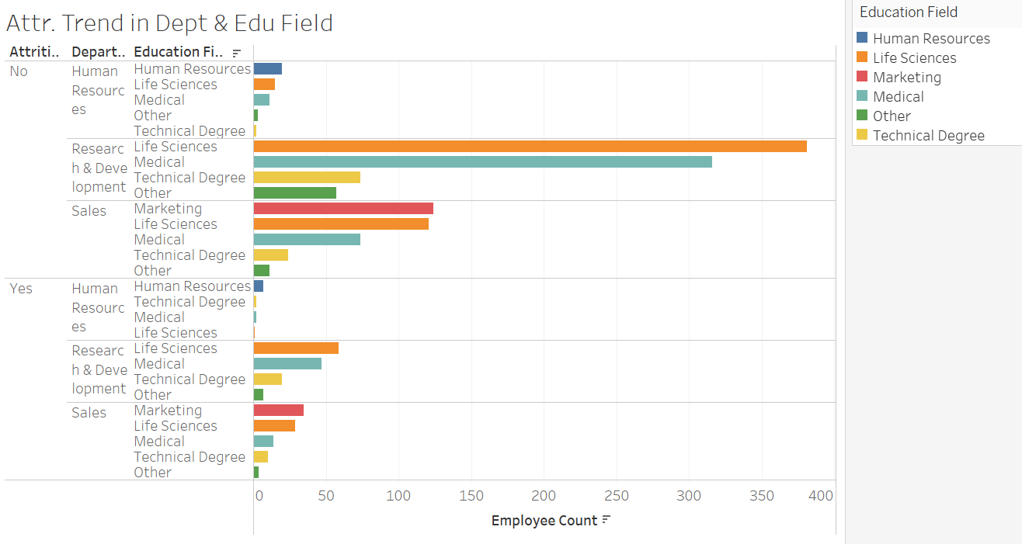

Slide 13
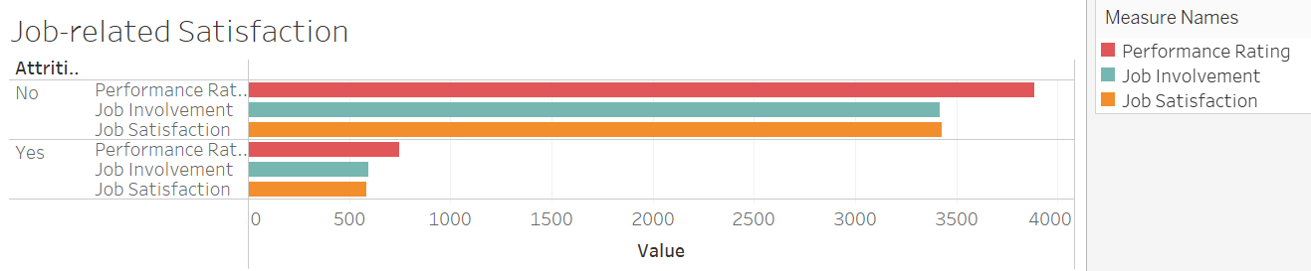

Slide 14
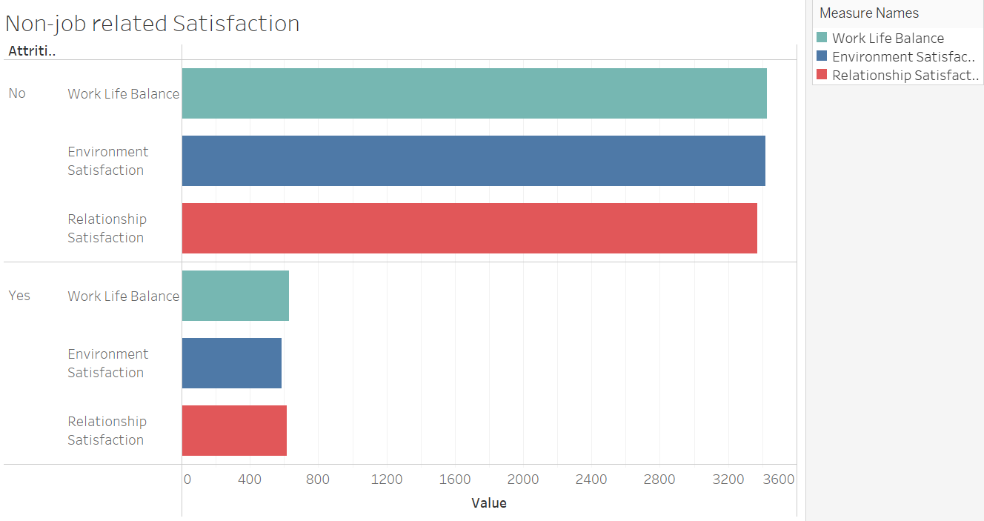

Slide 15
Insight & Analysis
Notes:
Transisi antar outline

Slide 16
Insight
From the first visualization we can say that the ones who happen to come from R&D department with Life Sciences educational field has the highest rate of attrition while HR dept with Life Sciences educational field has the lowest rate of attrition. Despite the fact that R&D with Life Sciences educational field has the highest rate, it also has the highest rate of the ones that attrition is less likely to happen.
From the second visualization (related satisfaction), the ones who are prone to attrition are having low performance rating, low job involvement, and low job satisfaction compared to the ones who are not.
From the second visualization (non-job related satisfaction), the ones who are prone to attrition are having low work life balance, environment satisfaction, and relationship satisfaction compared to the ones who are not.

Slide 17
Analysis
From the insight we have gathered, it can be concluded that despite R&D people has the highest rate of not getting involved in employee’s attrition, the ones who are involved in are most likely come from that department which means there’s something that causes R&D people have the tendency to leave first.
Following the factors that might be the cause of the case, the non-job and job-related satisfaction play a big role to encourage people to leave the company.

Slide 18
Thank you!
Notes:
Transisi antar outline

